Slide 1
Shine Job Scraping & Trend Analysis
By Nishant

Slide 2




Agenda
Imports Libraries
Job Details Scraping from Shine
Data Import & Export
Data Cleaning & Wrangling
Data Analysis

Slide 3
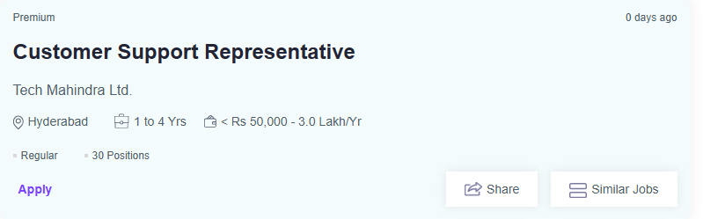
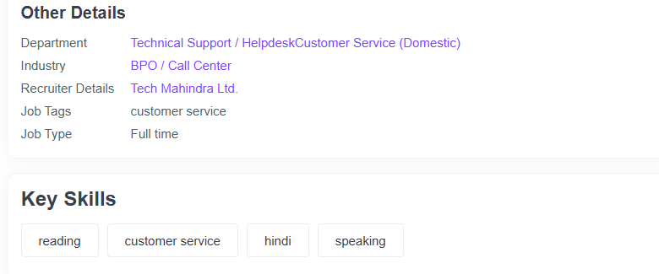
The power of Web-scraping beautiful soup is very powerful tool to scrap data from any web so I have used it in this project by scraping details from shine. scraped data from shine: 1. Title 2. Firm Name 3. Location 4. Experience 5. Requirement 6. Position 7. Salary Range 8. Job Type 9. Industry 10. Department 11. Recruiter 12. Job Tags 13. Job Posting Day

Slide 4
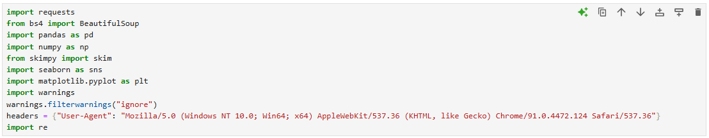
Import Libraries

Slide 5
Shine Web-Scraping

Slide 6
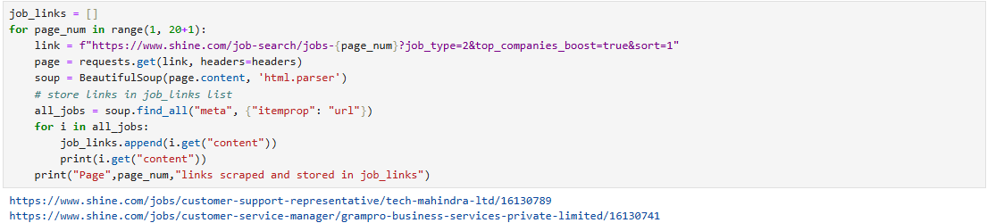
Scrap Job Post Links from 20 Pages

Slide 7
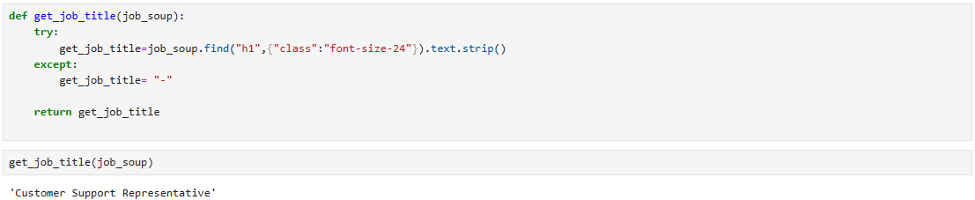
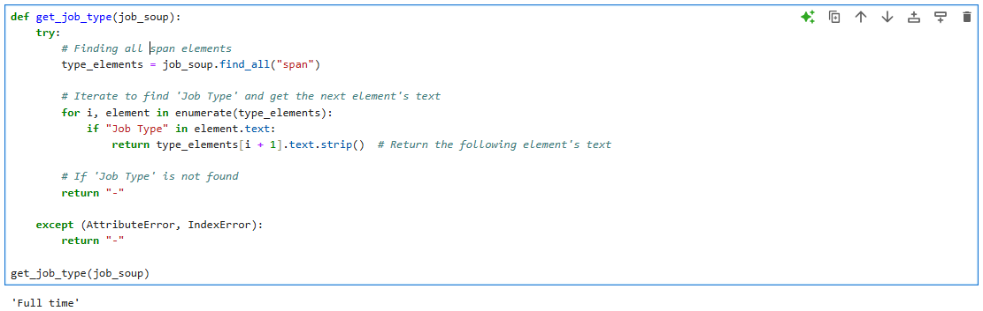
Create multiple functions to scrape details from job post page

Slide 8
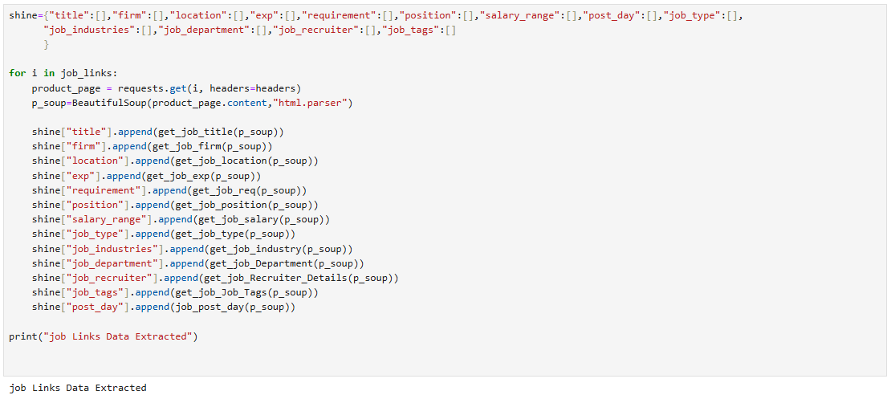
Scrape Details from Job Post & Store in Dictionary

Slide 9
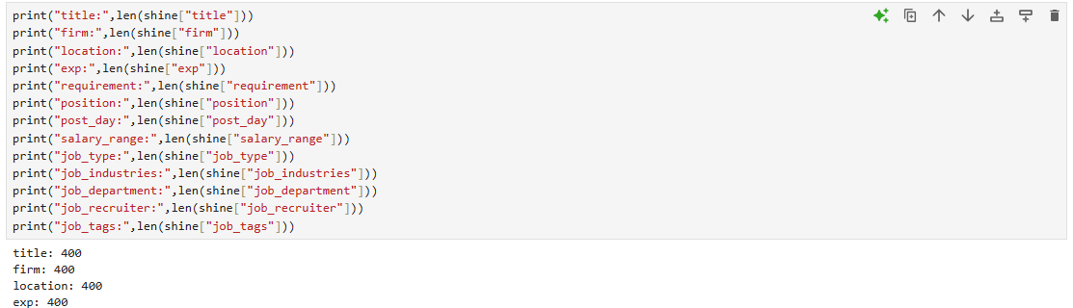
Total Extracted Data

Slide 10
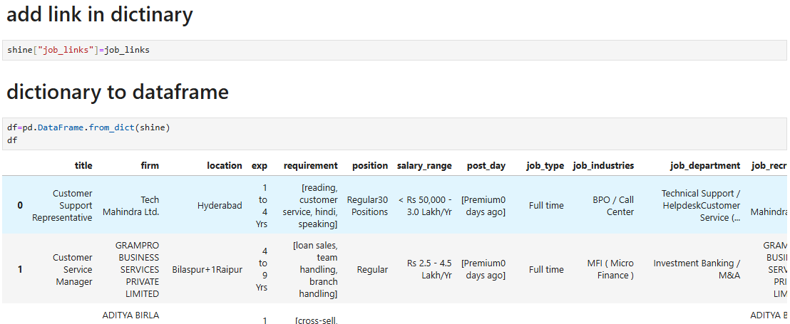
Merge Job link with dict. and Convert it Into Data Frame

Slide 11
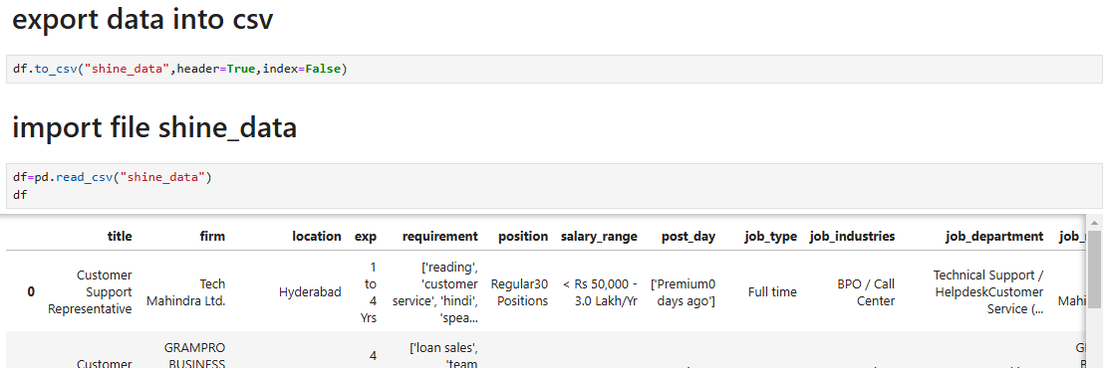
Import & Export Data

Slide 12
Data Cleaning & Wrangling

Slide 13
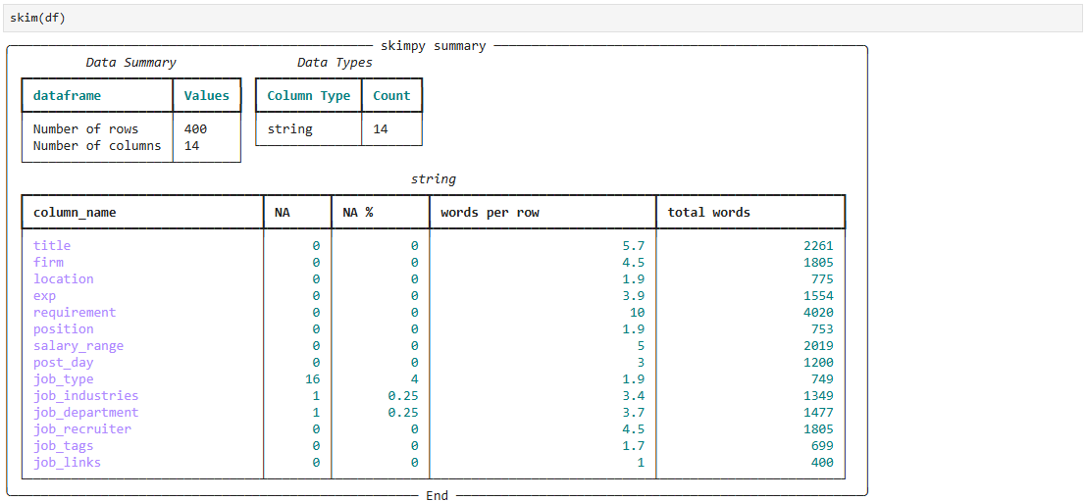
Data Summary

Slide 14
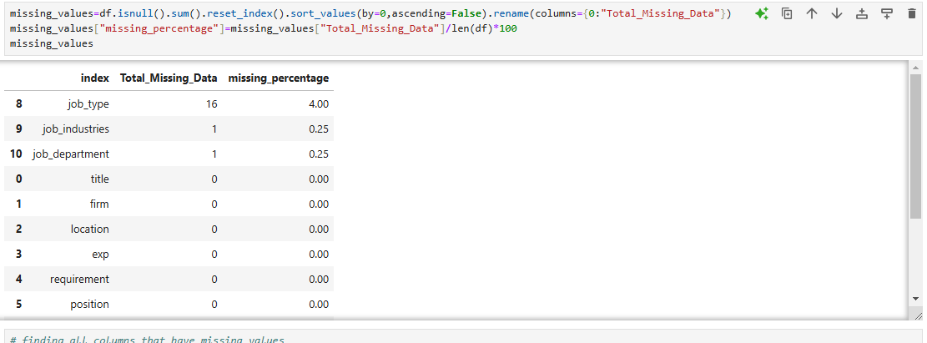
Check Missing Values & Missing Percentage

Slide 15
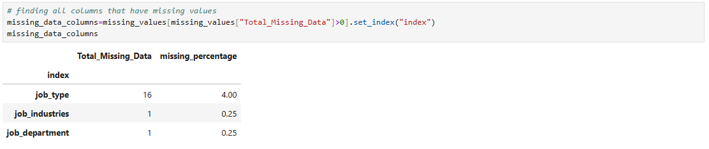
Find All Columns Names Which Have Missing Values

Slide 16
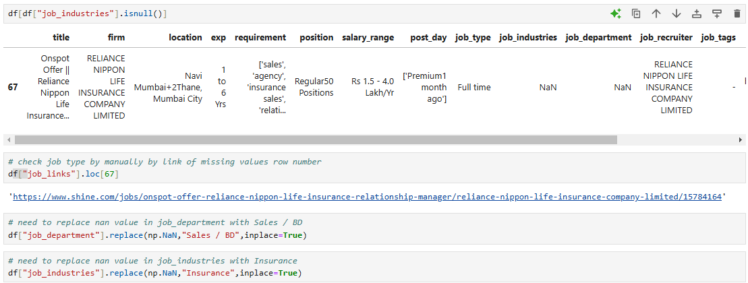
Handle Missing Values All 3 Columns

Slide 17
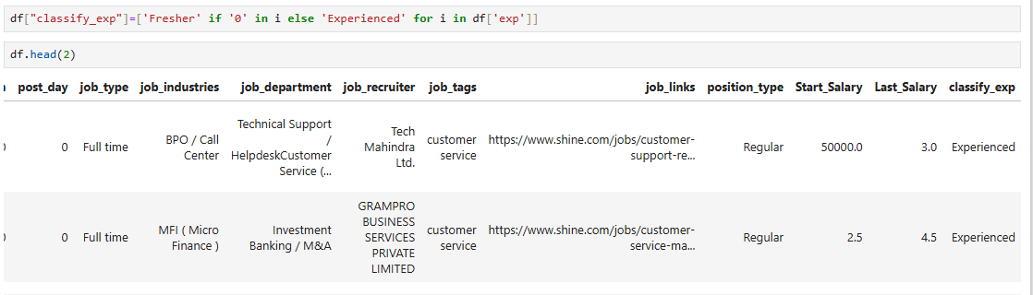
Create new columns on the basis on the data 1. position_type 2. Start_Salary 3. Last_Salary 4. classify_exp 5. total_company_branch 6. 1st_Branch_Name 7. 2nd_Branch_Name

Slide 18
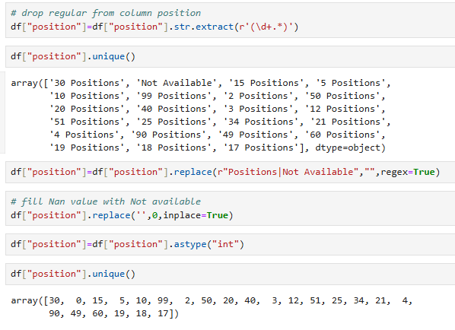
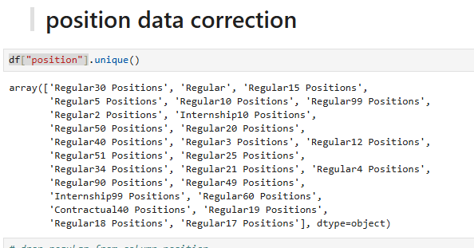
Columns Incorrect Value Correction in below columns 1. job_type 2. position 3. job_tags 4. post_day 5. Start_Salary 6. Last_Salary

Slide 19
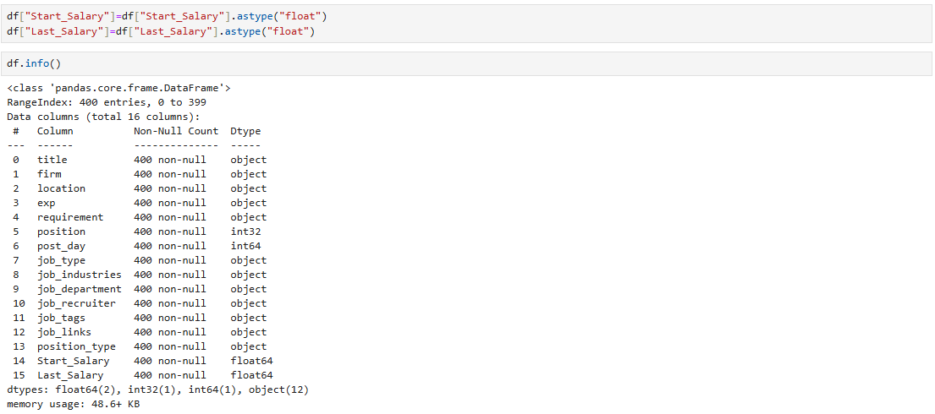
Change Data Type

Slide 20
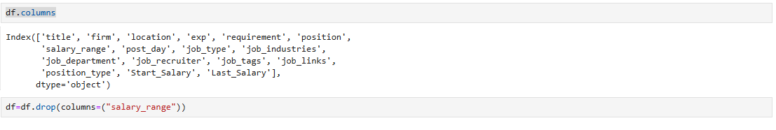
Drop Columns

Slide 21
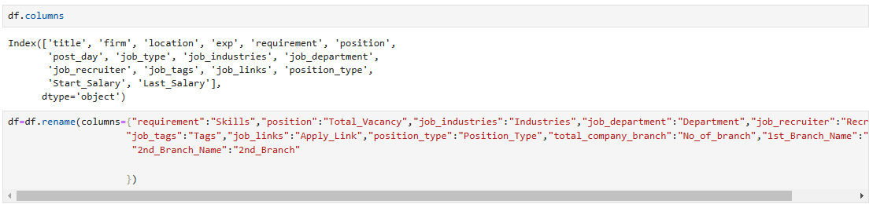
Rename Columns Name

Slide 22
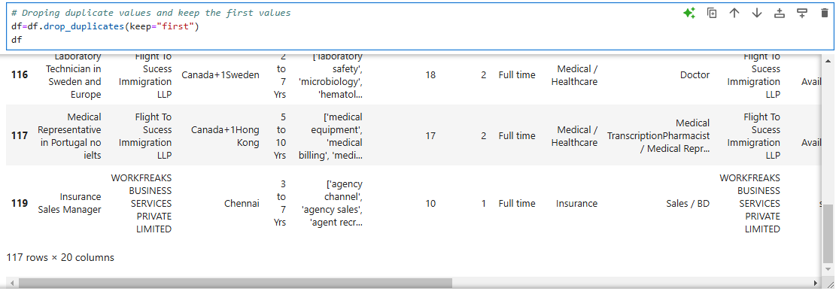
Dropping Duplicate Values from Dataset

Slide 23
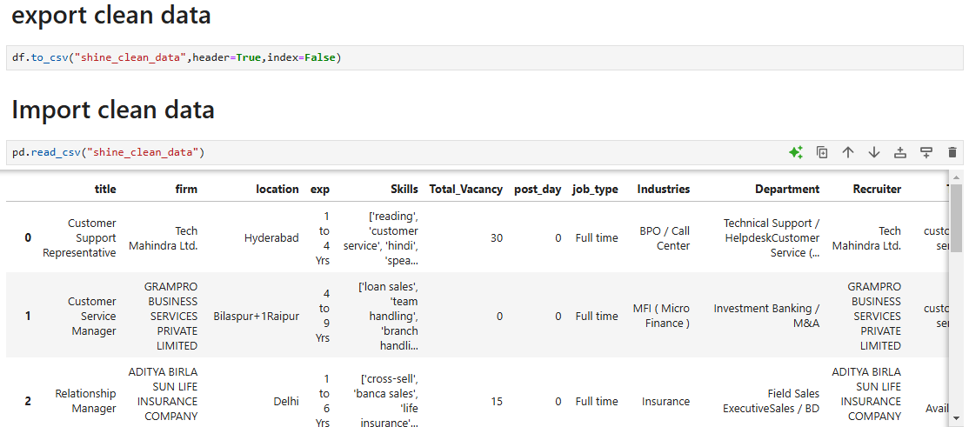
Import & Export Clean Data

Slide 24
Exploratory Data Analysis (EDA)

Slide 25
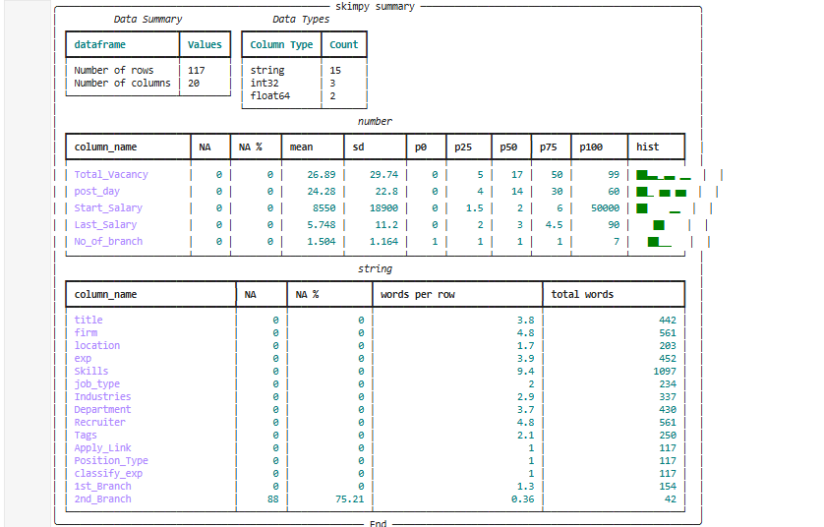
Data Exploration

Slide 26
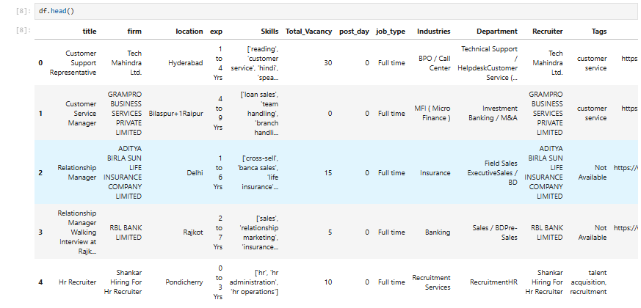
About Data

Slide 27
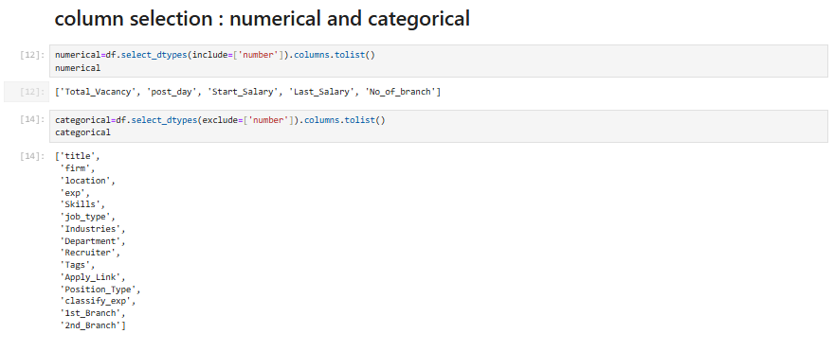
Numerical & Categorical Column Selection

Slide 28
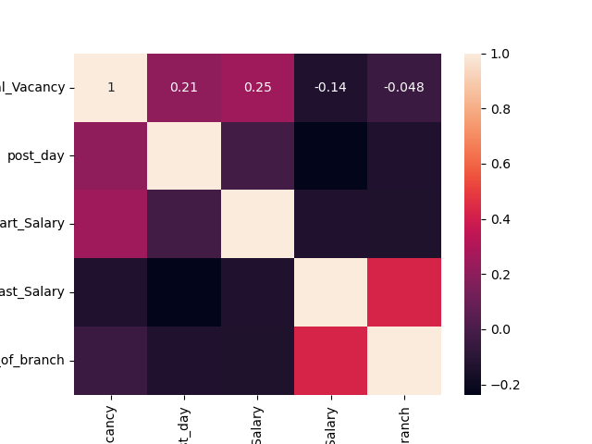
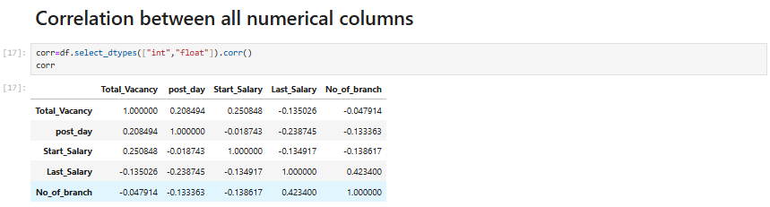
Correlation Between All Numerical Columns

Slide 29
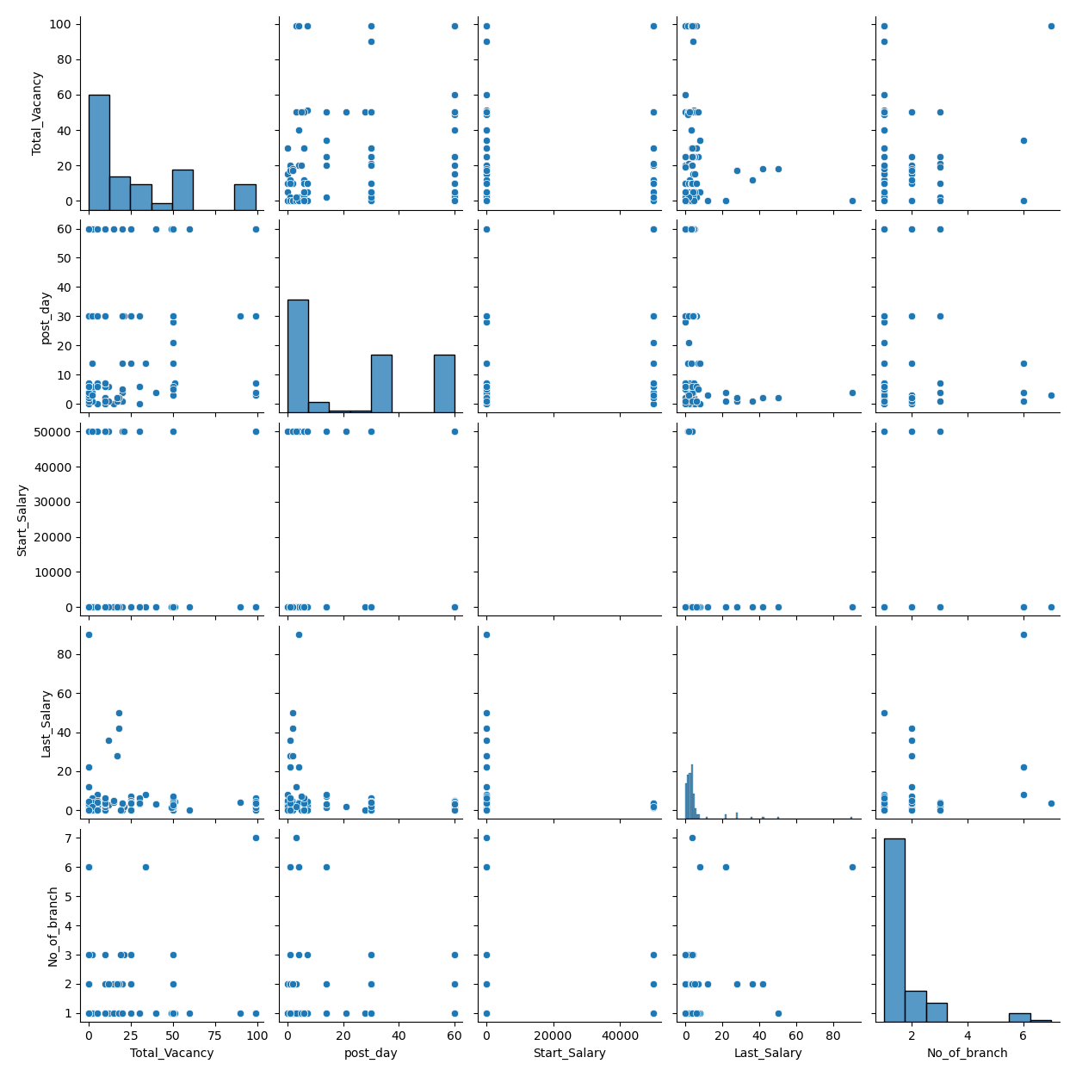
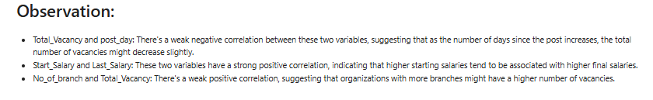

Slide 30
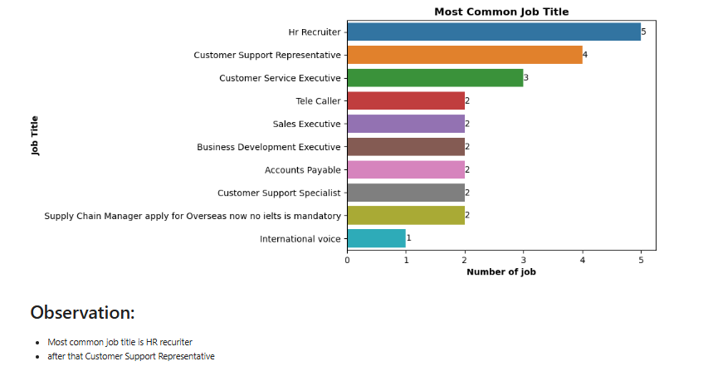
What are the Most Common Job Titles?

Slide 31
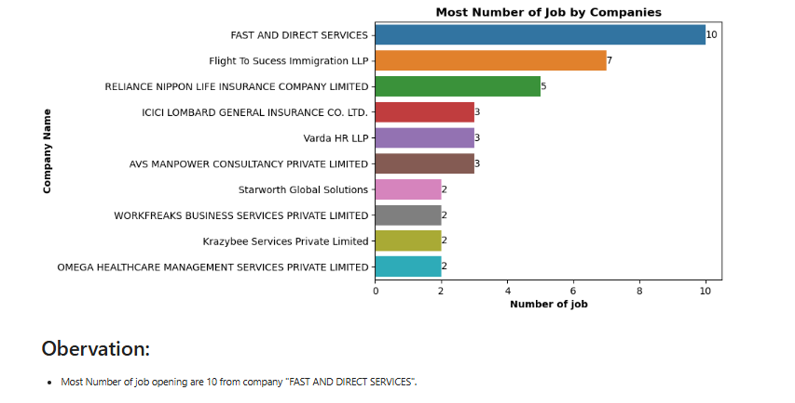
Which companies have the most job openings?

Slide 32
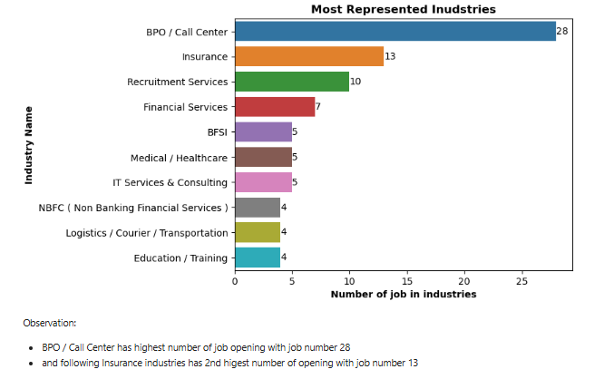
What industries are most represented in the dataset?

Slide 33
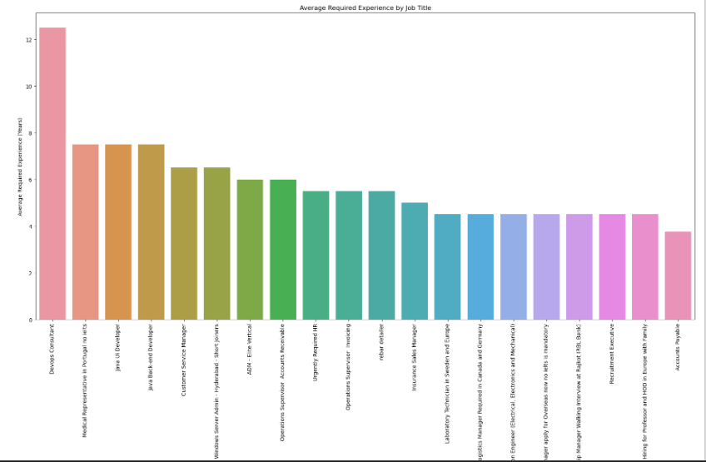
How does required experience (exp) vary across job titles?

Slide 34
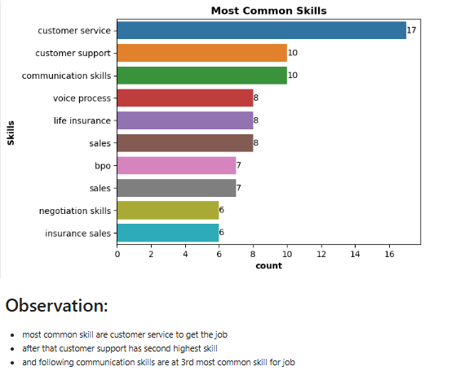
What are the most common skills listed for jobs?

Slide 35
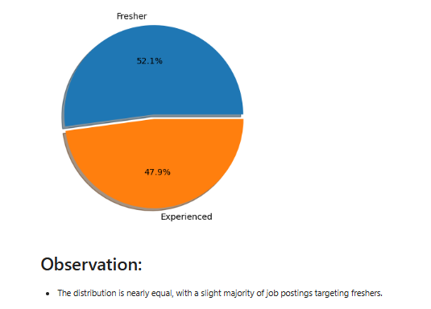
How does the distribution of experience levels (e.g., "Fresher," "Experienced") look across the dataset?

Slide 36
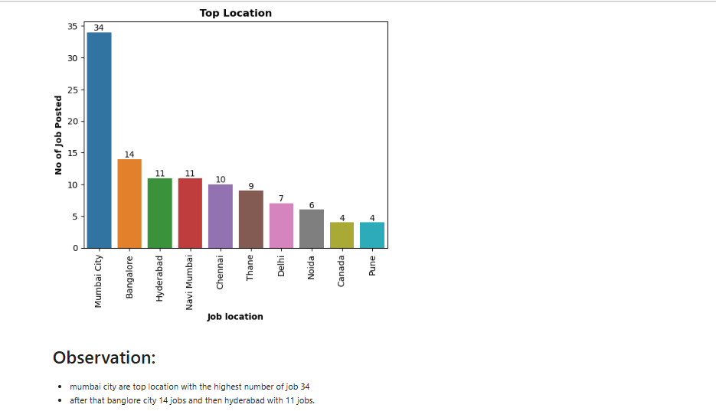
What are the top locations for these job listings

Slide 37
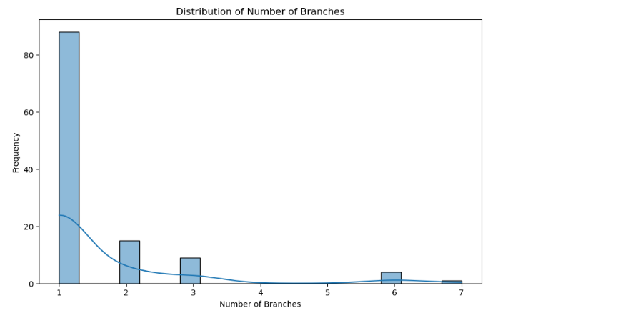
How many branches do companies typically have, and where are they located?

Slide 38
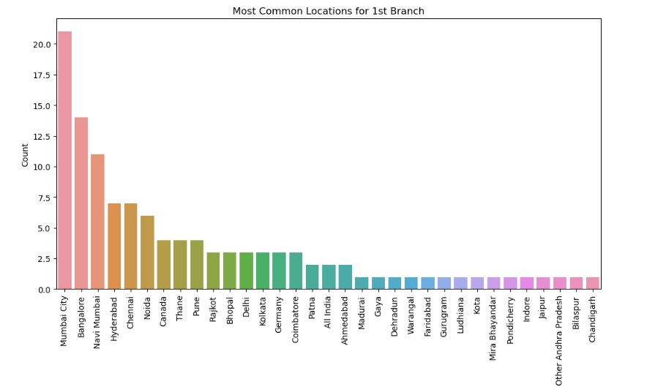

Slide 39
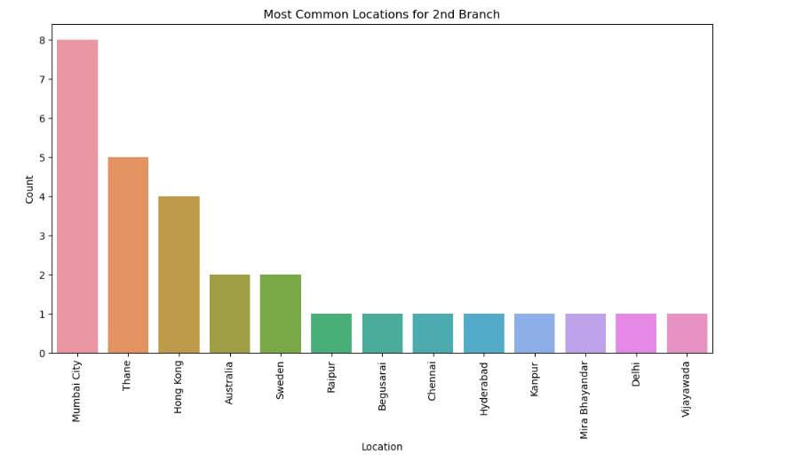
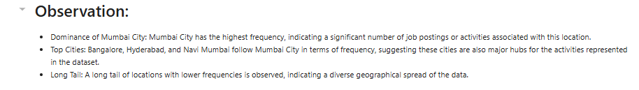

Slide 40
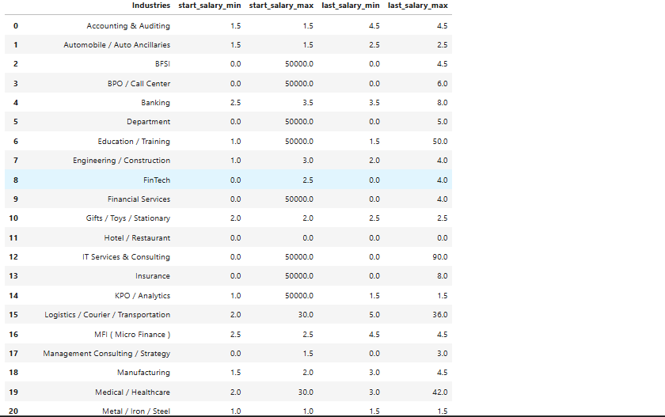
What is the range of starting and last salaries for jobs in each industry?

Slide 41
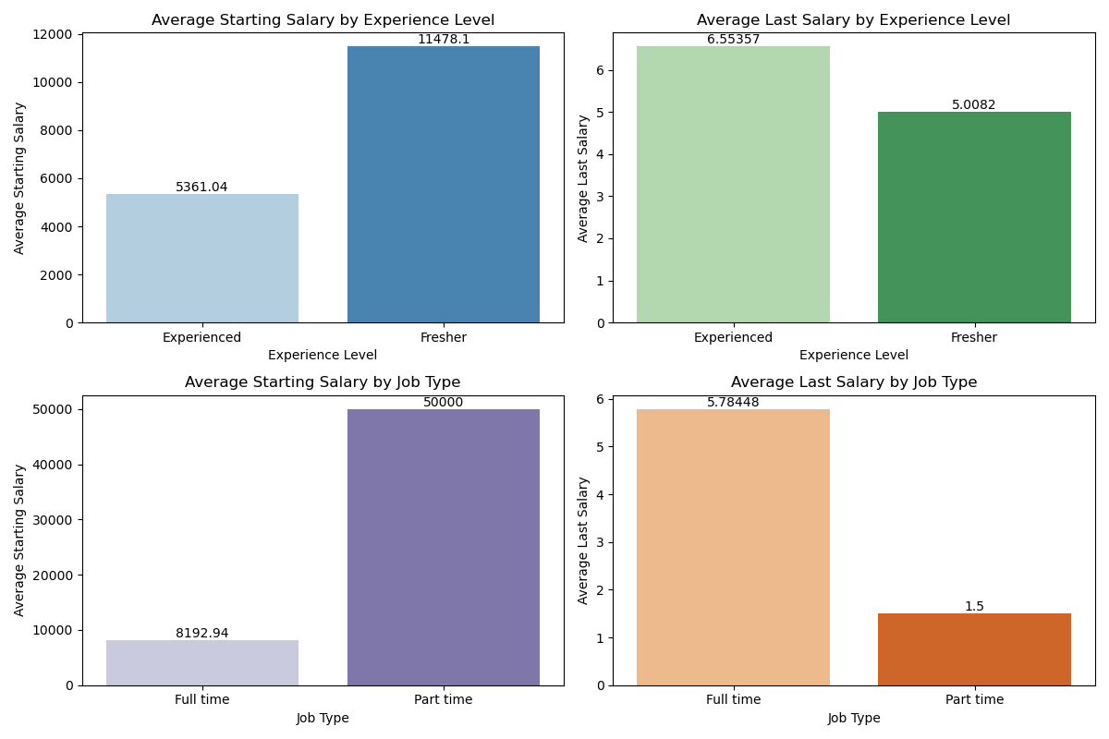
How does the salary vary with experience and job type?

Slide 42
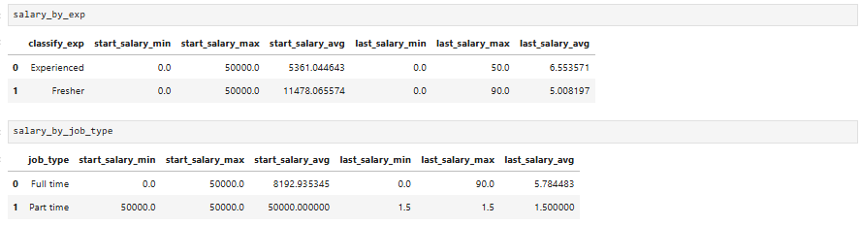
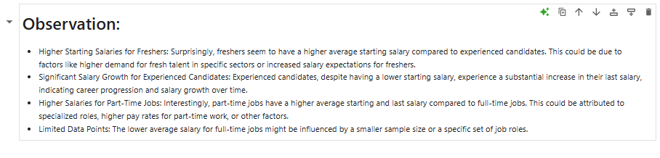

Slide 43
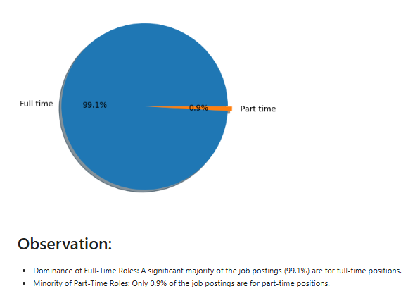
What proportion of jobs are full-time versus other types?

Slide 44
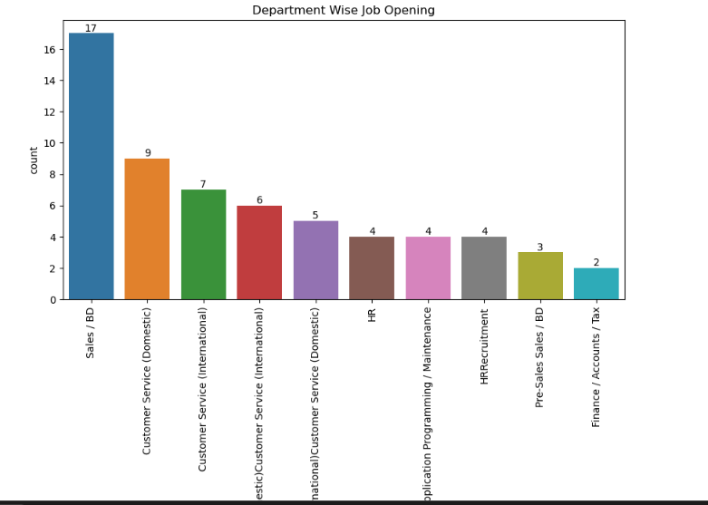
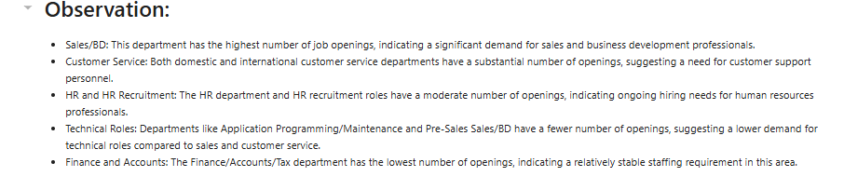
What departments have the most job openings?

Slide 45
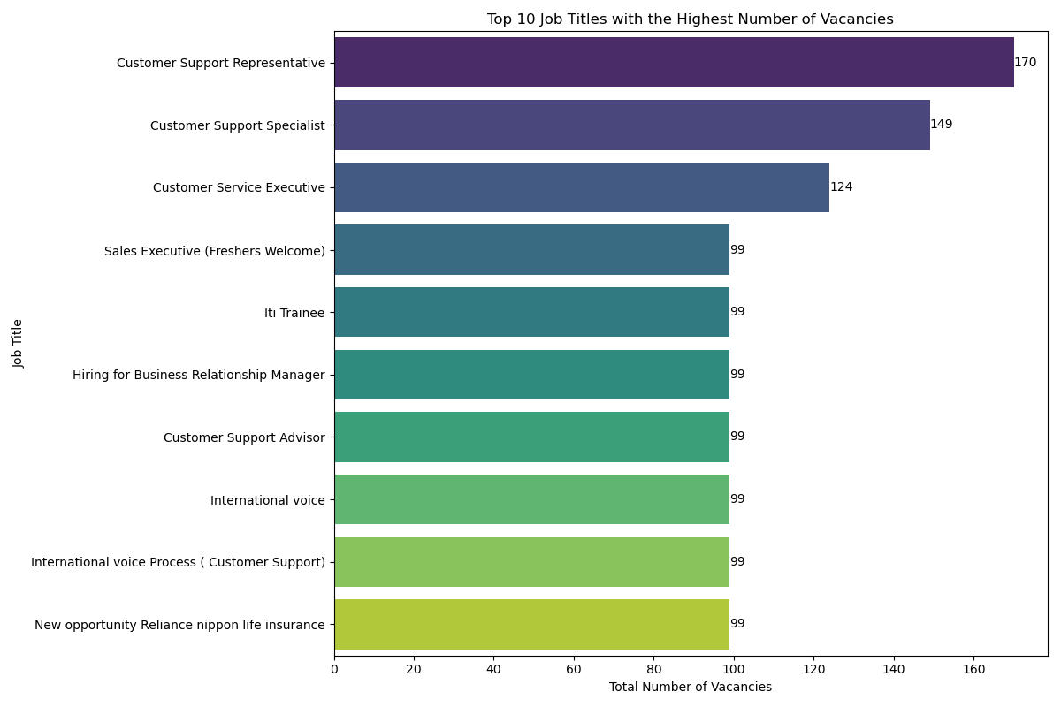
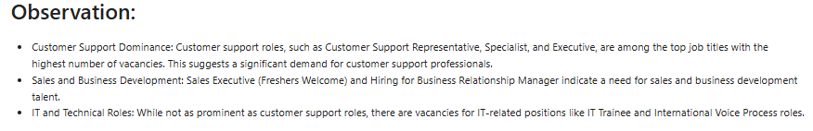
Are there patterns in the number of vacancies across different job titles?

Slide 46
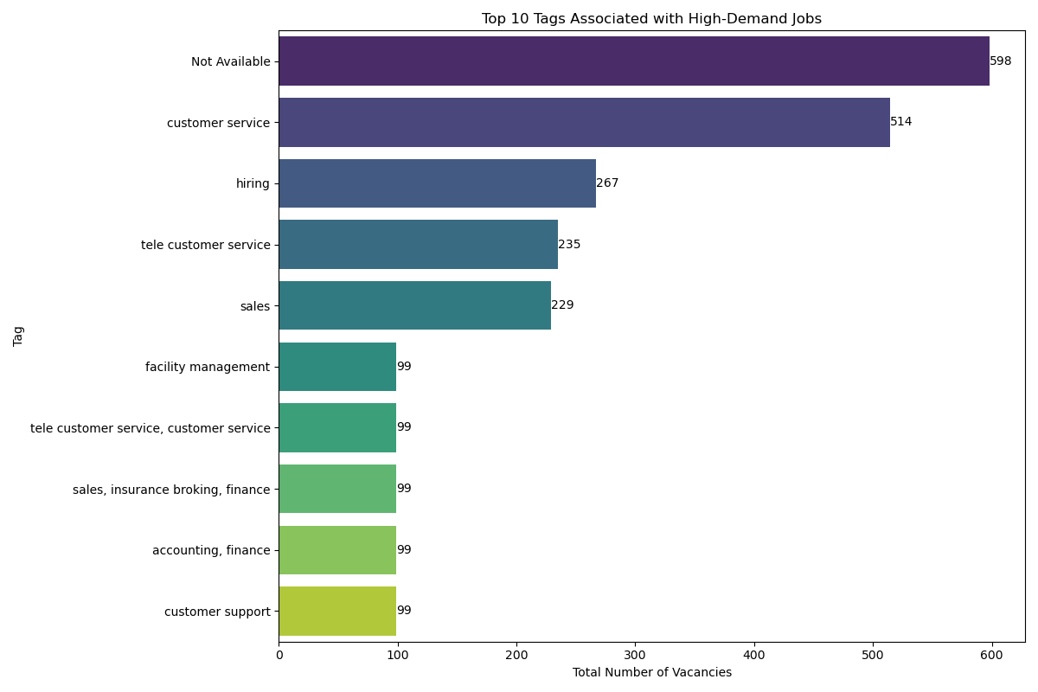

What tags are most associated with high-demand jobs?

Slide 47
Thank you
Nishant
Nishant575051@gmail.com
Linkdin : www.linkedin.com/in/nishant-kumar-data-analyst
Github : https://github.com/Nishant6020

